Slide 1

Advisory System for Decision Making in Crop Protection
EPINET Co., Ltd.
Yong Kyu Han

Slide 2
Contents
Spin off
Footstep
Technology
Commodity
People

Slide 3
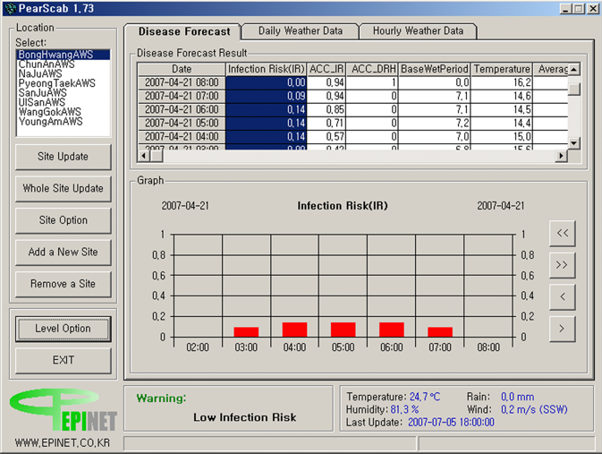
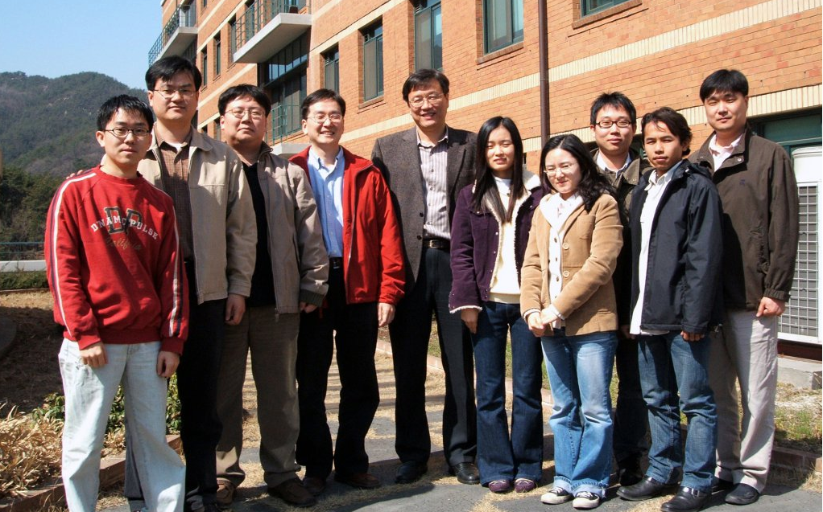
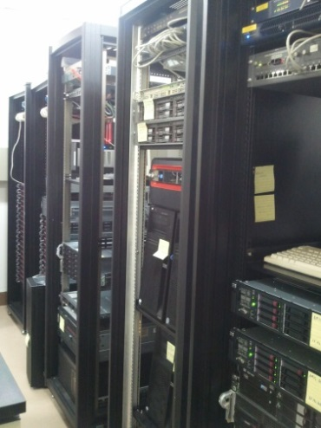
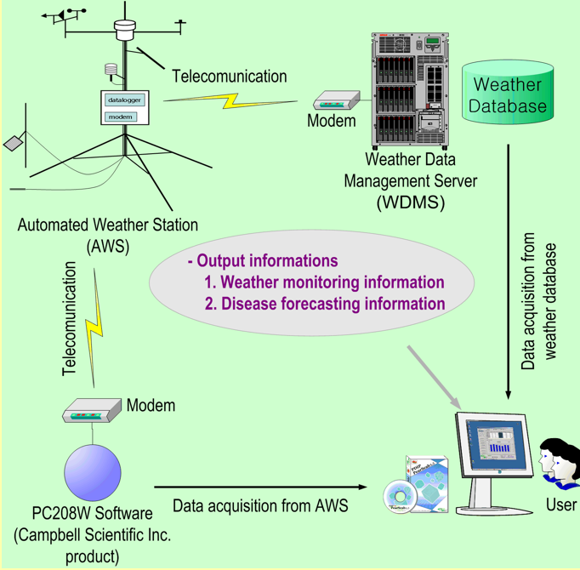
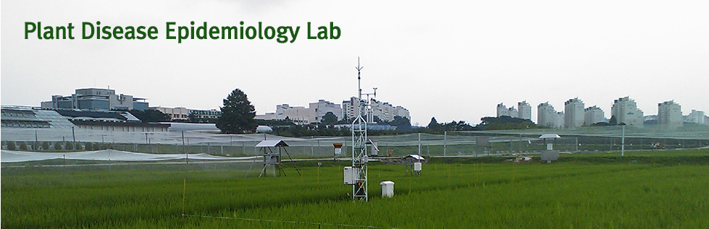
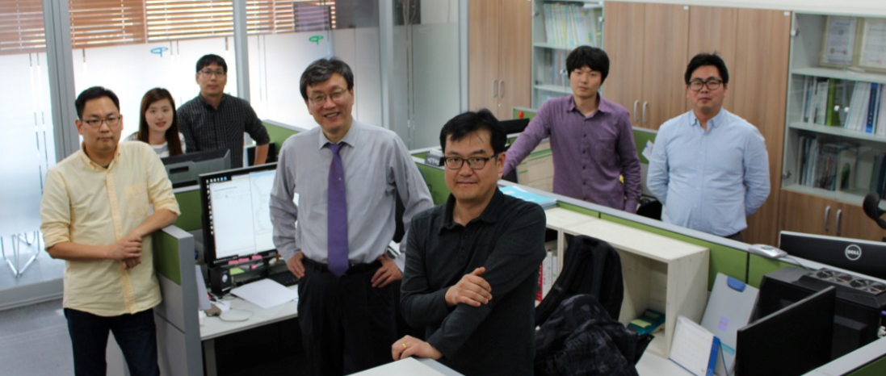
Spin off
EPINET was founded as a venture business of the plant disease epidemiology laboratory(PDEL) of Seoul National University in 2002, which was the same year as the FIFA World Cup hosted by Korea.
We first developed PearScab® in the same year. PearScab® provides not only meteorological information for specific areas but also forecasting information on the occurrence of pear scab, a disease which can lead to devastating damage in pear orchard.
The development of the software marked a turning point which provided an innovative improvement to agricultural extension services regarding the pear producing areas.
Weather monitoring information
  Maximum, minimum and average of air temperature(℃), relative humidity(%), ground temperature(℃)
  Wind speed(m/s) and direction(degree)
  Leaf wetness(hr/hr)
  Rainfall(mm)
  Solar radiation(MJ/m²)
Disease forecasting information
  Infection risk
  Accumulated infection risk
  Base wet duration hours(hr)
  Infection warning message
Overview of PearScab® system

Slide 4



Our footstep
Start up 2002~2005
Sep., 2002. Incorporation
Oct., 2002. Business Registration (Registration of EPINET Co., Ltd.)
Jan., 2003. Developed PearScab® for the first time in Korea(MS Windows-based)
May, 2003. Software Business Declaration
Apr., 2004. Appreciation Award Plaque (Seoul National University)
Mar., 2005. Registration of Venture Company in Korea
Growth 2006~2013
Sep., 2006. Poster exhibition at Agriculture and Forestry Science Technology Exposition
Oct., 2007. IAPPS presentation
Sep., 2008. MEST Administrator Award – Plant disease & Pest Forecasting System
Dec., 2008. Plant Disease & Pest Management system on fruit trees – Consignment Contract
Nov., 2009. Technological Progress Award (Korea Society Agricultural & Forest Meteorology)
Apr., 2010. Relocation of Head Office (Anyang-si, Gyeonggi-do, Republic of Korea)
Mar., 2011. Launching AgCast® Products
Oct., 2012. Establishing Research Institute
Feb., 2013. Reporting R&D Service Industry
Advancement 2014~
Jan., 2014. Reorganizing the Company
Apr., 2014. Registering as Weather Company (KMA)
Dec., 2015. 1st Administrator Award(RDA)
Jun., 2016. Venture Business Company Certification
Oct., 2017. 15th Anniversary of Foundation
Nov., 2017. ISO 9001 Quality Management Certification
Nov., 2017. INNOBIZ Certification
May, 2018. 2nd Administrator Award 2nd(RDA)
Apr., 2019. Extension of Head Office

Slide 5
Our technology
Our company collects numerical data in agricultural environment and identify plant responses to climate change. We implement biometeorological information delivery services(BIDS) based on empirical or statistical analysis using numerical data. BIDS provide users with site-specific agricultural information via Web and mobile applications.
EPINET as a unique venture in operating agroclimate systems, has an immense processing capacity that collects and process numerical weather data to establish agricultural environment information service.
Technology
Processing AgMet data using various meteorological models
Plant disease and insect pests forecast system
High resolution Web-GIS
Software development and system integration
Real-time information system
Mobile application development
Bio
Technology
Information Technology
Environment Technology
Agricultural Information Service

Slide 6
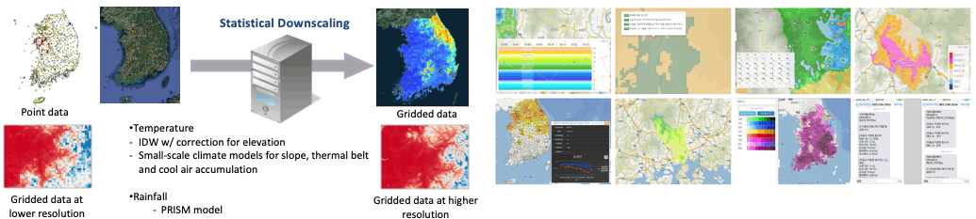
Our technology – Real time weather/climate downscaling
Local climate downscaling by using spatial interpolation methods
Our company implement several downscaling technologies including Inverse Distance Weighting (IDW) and geospatial climate prediction scheme, which can generate site-specific weather data at a landscape scale in order to enhance the use of weather data.
Downscaling technology for weather data
  High-resolution downscaling technique (Spatial resolution: 30m x 30m, 240m x 240m)
  Weather data processing technology by using Geospatial climate prediction scheme
  Implementation technology of digital climate maps at a high resolution based on Web-GIS
Agrometeorological information service
  Basic Digital Climate Map (Daily maximum/minimum temperature, solar irradiance, precipitation)
  Secondary Digital Climate Map(Daily temperature variation, the first and end date of frost, Extreme minimum temperature, growing degree days, etc.)
  Analytic Digital Climate Map (Plant disease risk, Ripening date, Sprouting date, Dormancy release date, etc.)

Slide 7
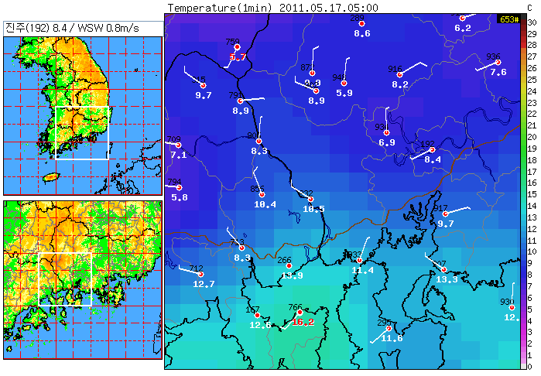
Our technology – Real time weather/climate downscaling
9℃
8℃
Dong-Nae(Digital) forecast resolution : 5km X 5km

Slide 8
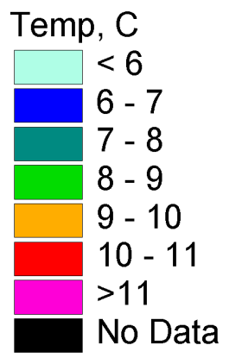

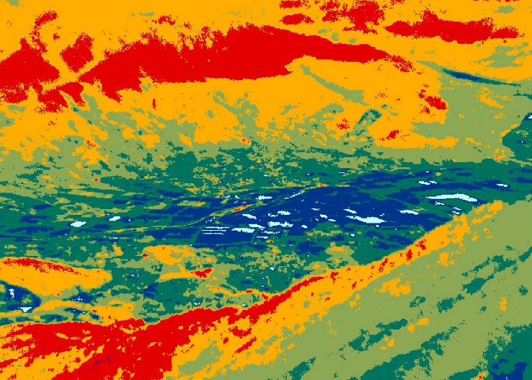
Our technology – Real time weather/climate downscaling
Yun, J. I., 2011: Observation of the cold-air drainage and thermal belt formation in a small mountainous watershed by using an infrared imaging radiometer. Korean Journal of Agricultural and Forest Meteorology 13, 79-86

Slide 9
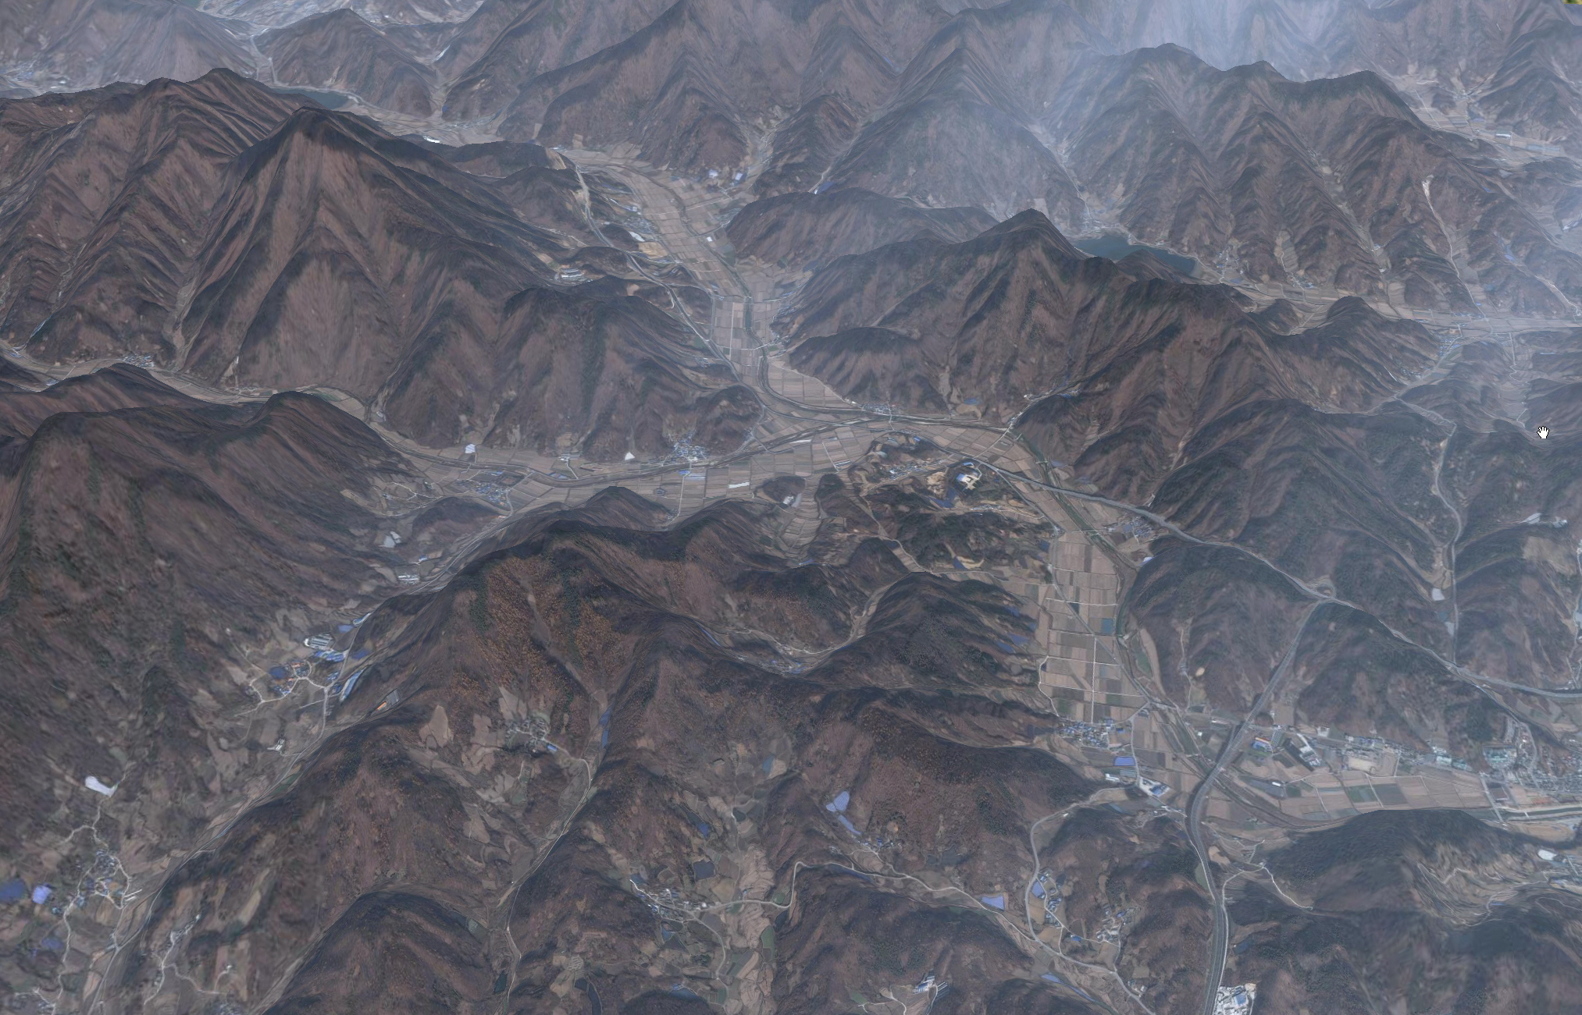


Our technology – Real time weather/climate downscaling
Sloped Surface
Solar irradiance
Thermal Belt
Cold-air Drainage
Cold Pool
Geospatial Climate Prediction Scheme for a Complex Watershed
Observation Site
#1
Observation Site
#2
“Estimation Site ?”
Observation Site
#3
Observation Site
#4
(2009-2017, Yun, etc.)

Slide 10
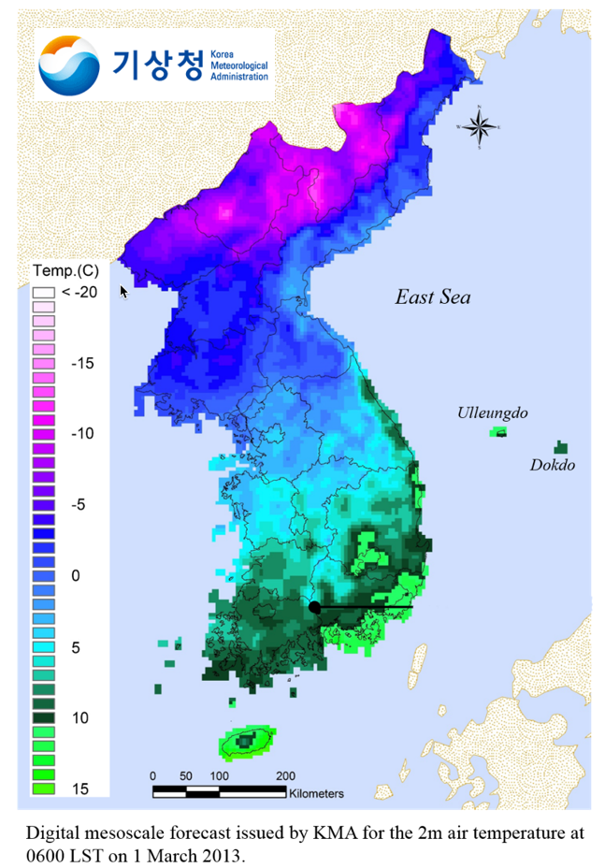
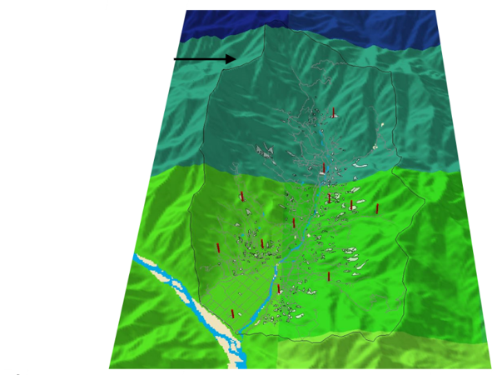
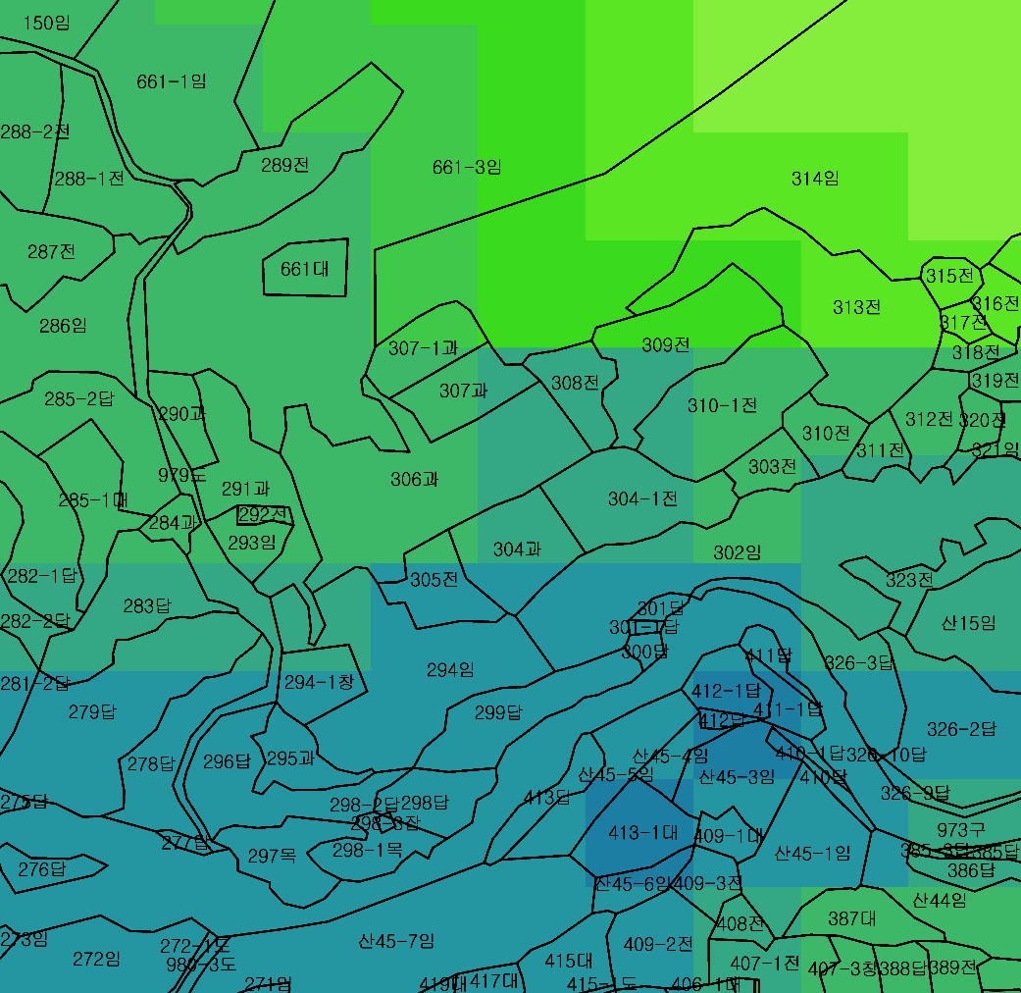
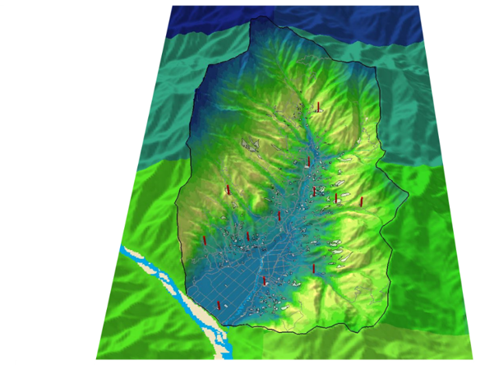
Our technology – Real time weather/climate downscaling

Slide 11
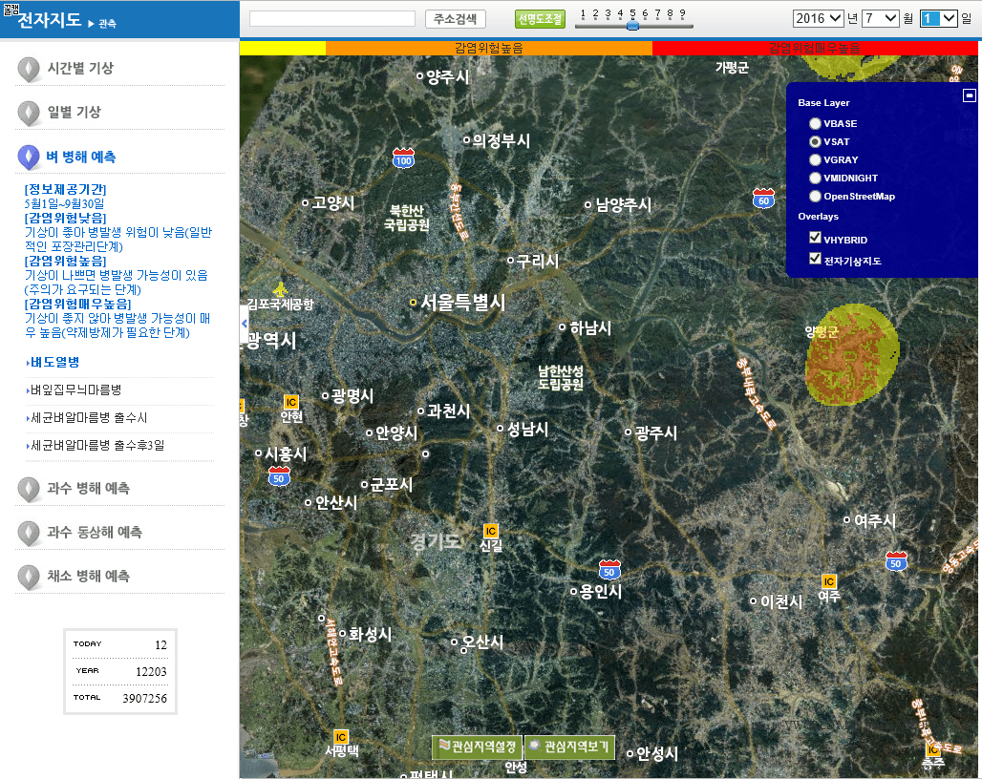
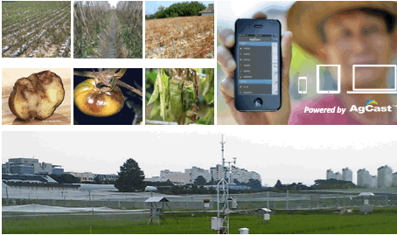
Our technology - Plant disease forecasting services
Plant disease and insect pest forecasting system
The information system for plant disease collects weather data observed from automated weather stations (AWS) and forecasts of numerical weather prediction model to provide users with crop disease forecasting information via Web. and mobile applications.
Characteristic of plant disease & insect pest forecasting system
  Expeditious and accurate prediction based on cluster analysis using big data
  Provision of user-customized information by integrated technologies on climate downscaling and agricultural weather service
Operation systems for plant disease and pest forecasts (Oct., 2002 - Dec., 2018)
  Pear, apple, grape, peach, citrus, persimmon, strawberry, pepper, rice,
  grass etc. (10 in total)
  Service for 27 diseases and 23 pests (50 in total)

Slide 12
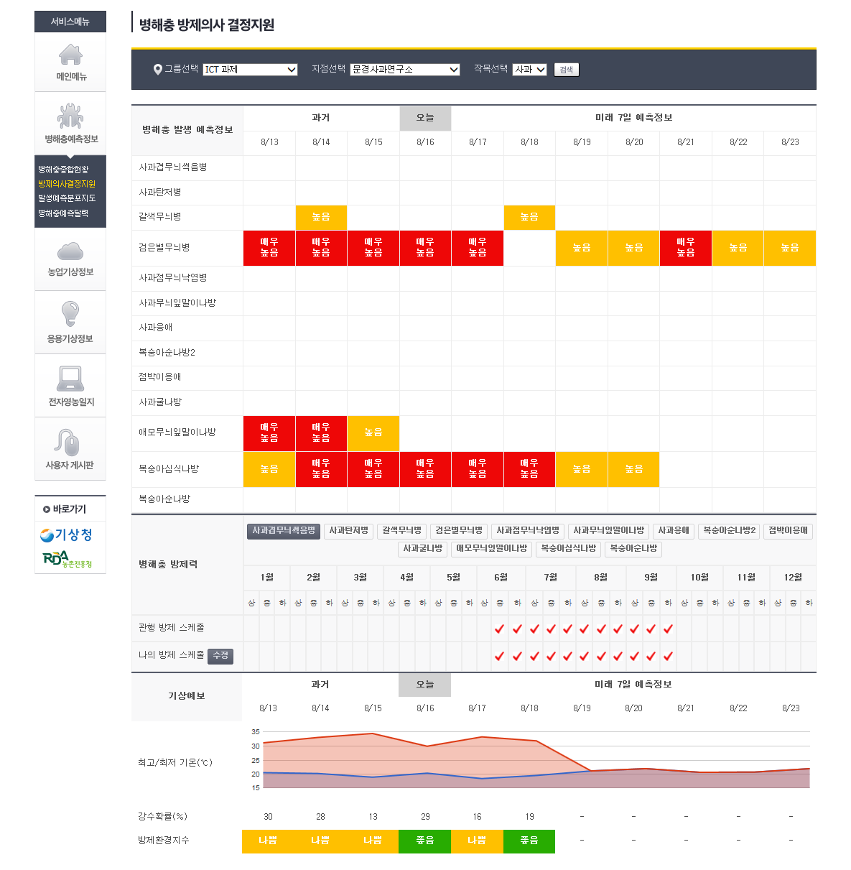
Our technology - Plant disease forecasting services
Decision making support
for pesticide spray control

Slide 13

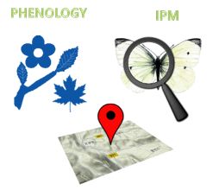
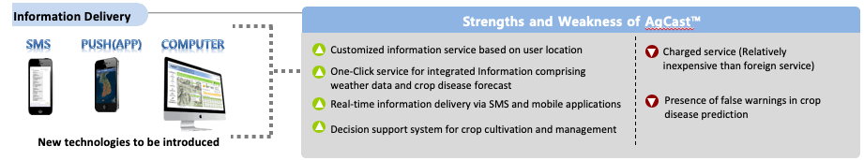
Our commodity - services
Farm-customized decision support system for crop cultivation
AgCast™ is an information delivery system to support farmers optimize farming decisions throughout the crop growing season. The system generates farm-specific information including agricultural weather data, plant disease forecasts, frost injuries, early warnings for extreme weather events, and real-time advisories for crop cultivation. Integrated information by the system can be used to prevent crop damage from disease, insect pests and severe weather events. AgCast™ is able to help crop growers be more productive on each acre of land and getting the most out of every harvest in the long run.
Agricultural weather data
  Customized weather data based on user location registered with the system
  Real-time weather data including (Temperature, relative humidity,
  precipitation, wind direction and velocity, etc.)
  Web-GIS based digital climate maps at a high spatial resolution (240m x 240m)
Applied weather data in relation to crop cultivation
  Farm-specific forecasting information for sprouting and blooming date of fruits (GDD)
  Frost alert service based on plant phenological information
  Severe weather warning service (Cold wave, hot wave, drought)
Plant disease and insect pests forecasting information
  Farm-specific information for crop disease and pest forecasts (Predictable period: 1~10 days)
  Early warning system for crop diseases and pests (warning level: no risk/ moderate/ high-risk)

Slide 14
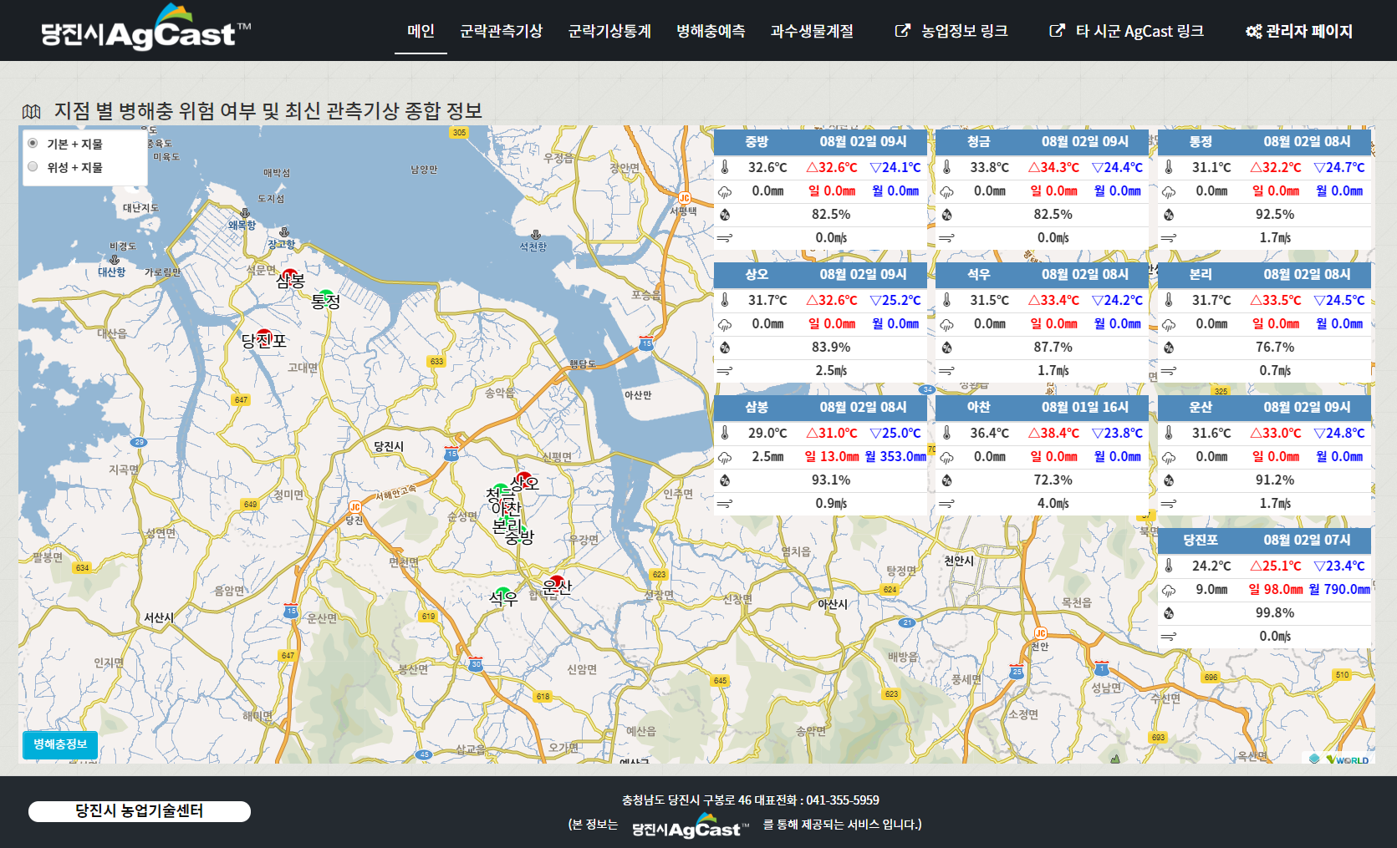
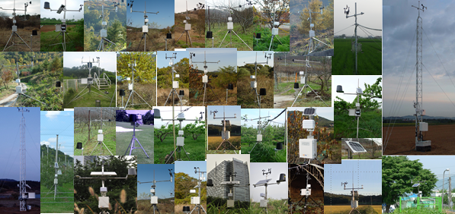
Our commodity - services
Realtime ag-weather information(http://dangjin.cnipm.kr)
Automated weather stations
(AWS)
Location and time
Observed Weather info.
Temperature, RH, Rain, Leaf Wetness, Wind, Soil temperature, Soil moisture, Solar irradiation, Daylight hours

Slide 15
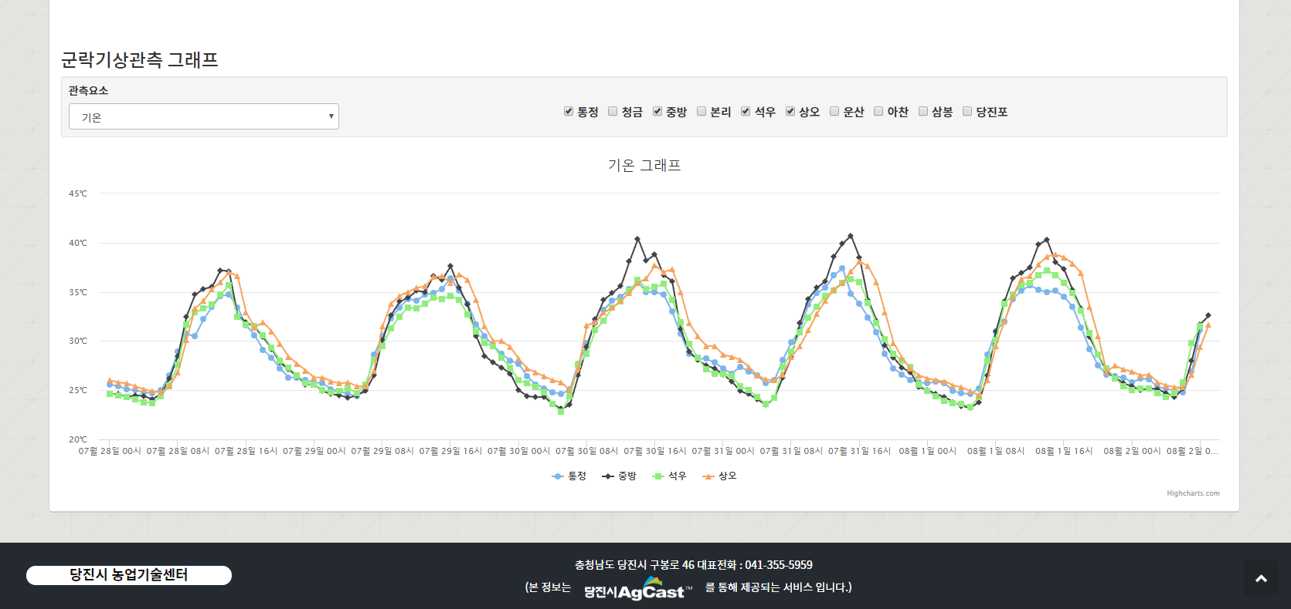
Our commodity - services
Site-specific ag-weather data in graph information
Comparison of ag-weather between observation sites

Slide 16
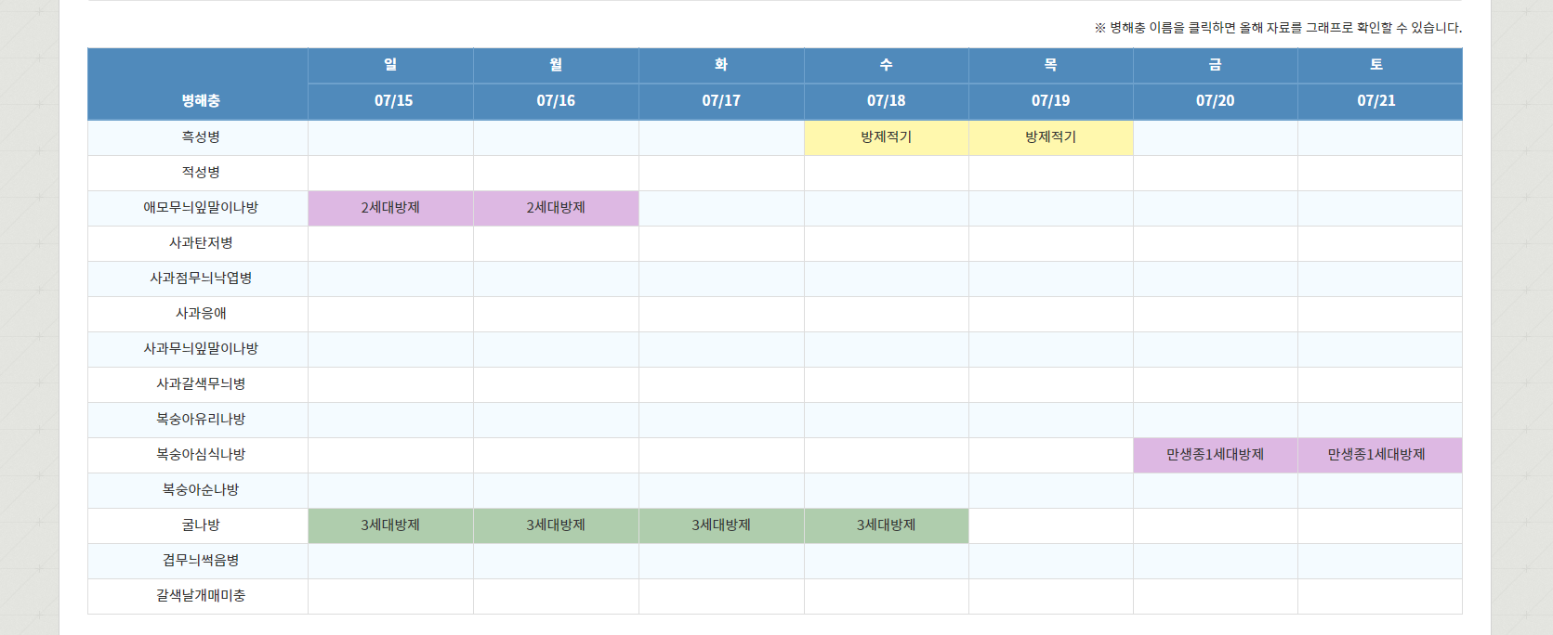
Our commodity - services
Disease & insect pests risk forecast
Risk forecast of diseases & insect pests using observed weather data
Decision support for pesticide applications

Slide 17
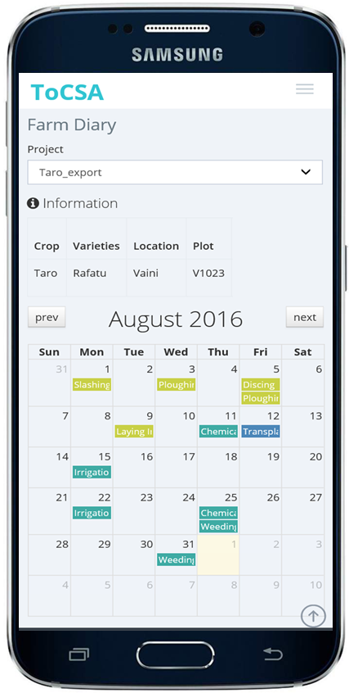
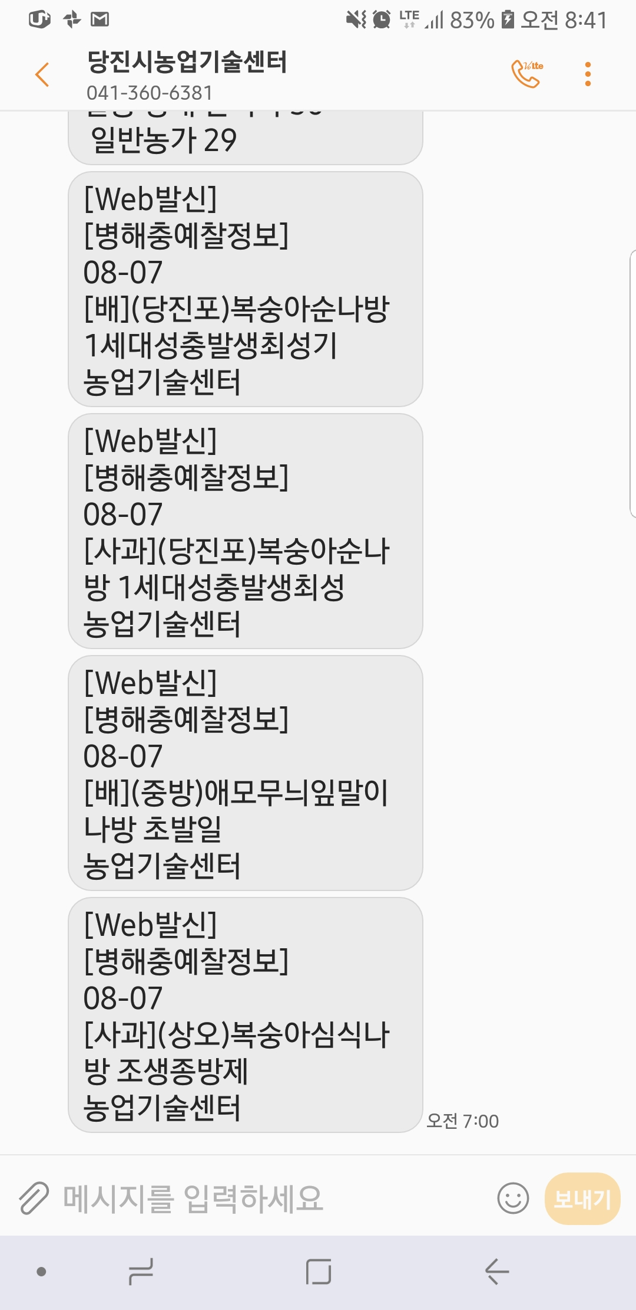
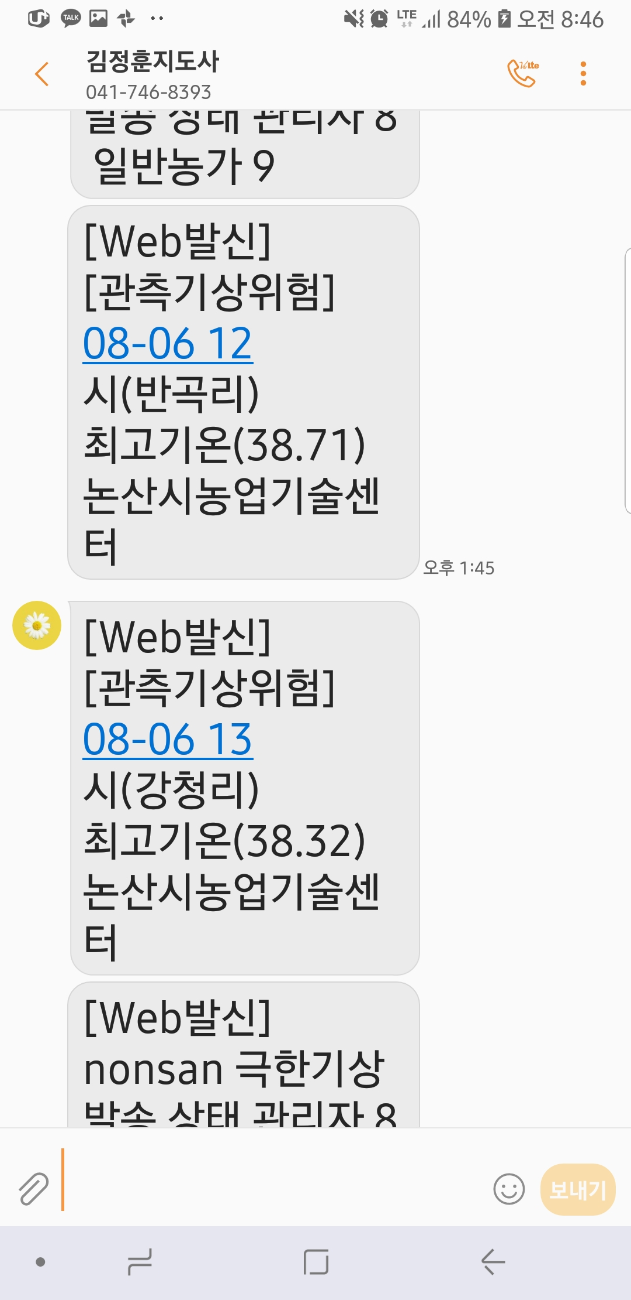
Our commodity - services
Daily texts on pest and weather risk through SMS
Pest risk text
Weather risk text

Slide 18
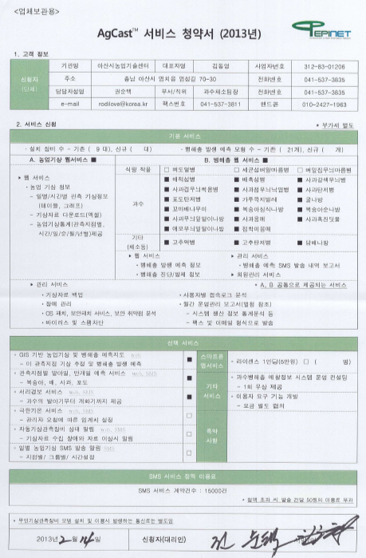
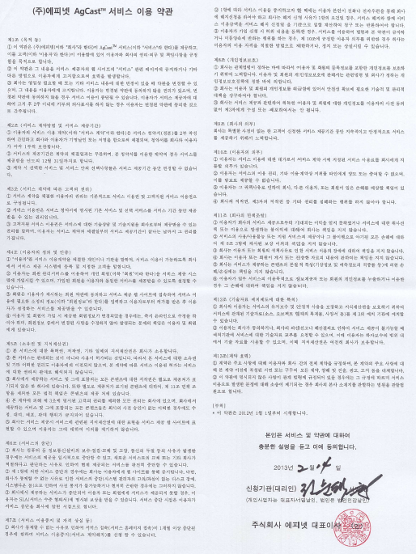
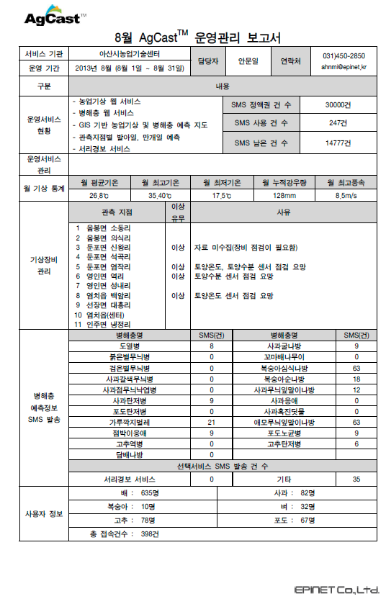
Our commodity - services
Service contract
Subscription
Term of services
Monthly operation report

Slide 19
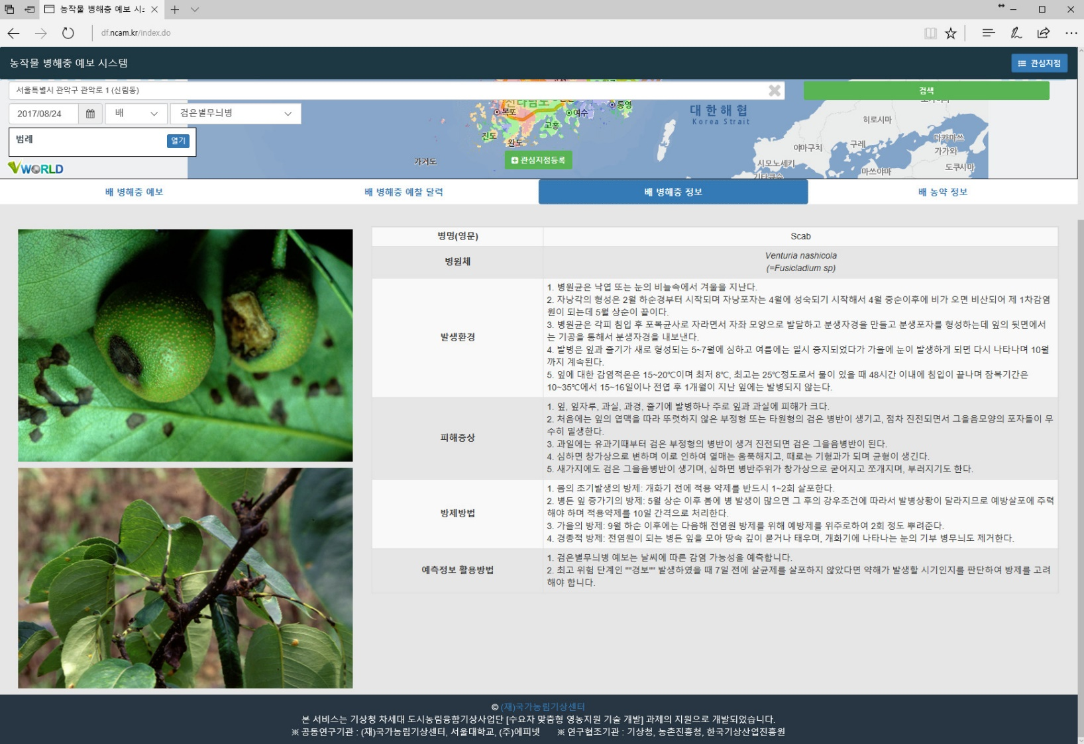
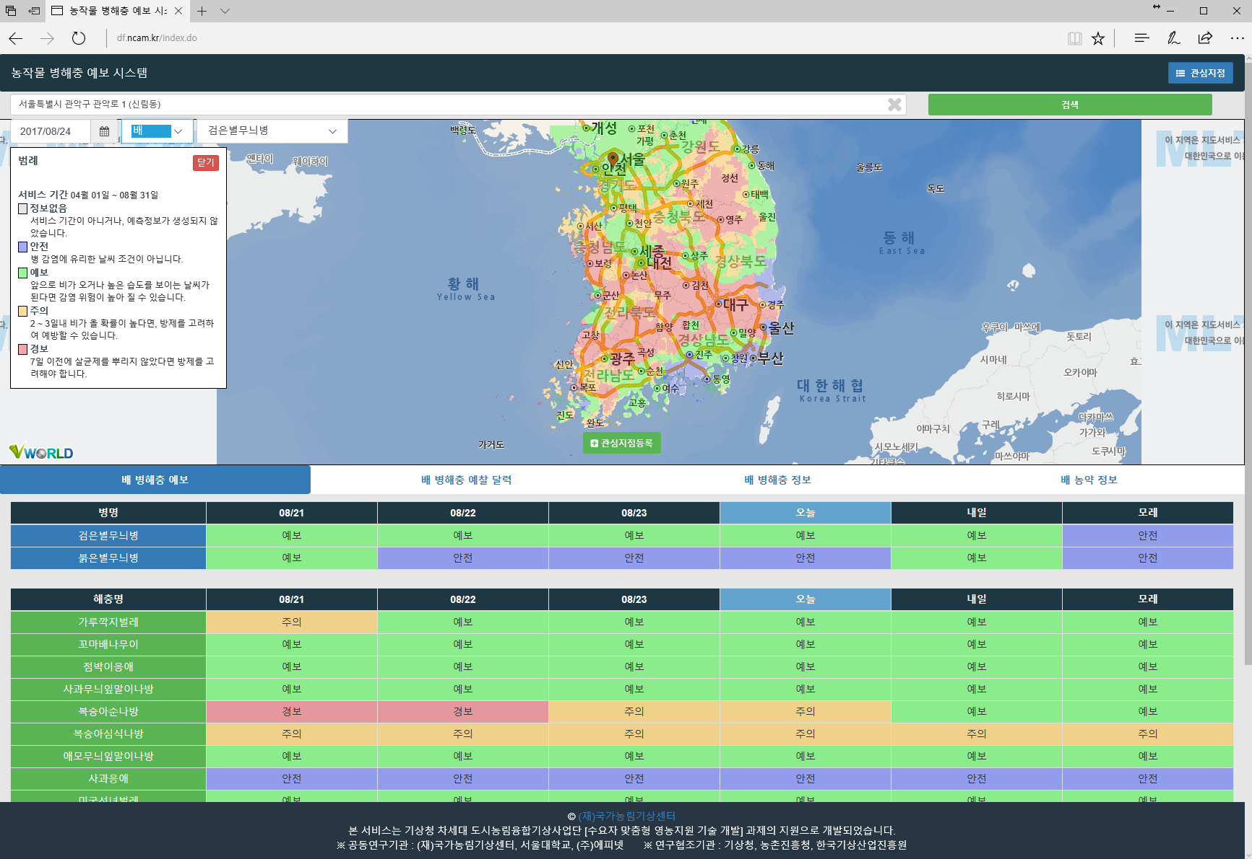
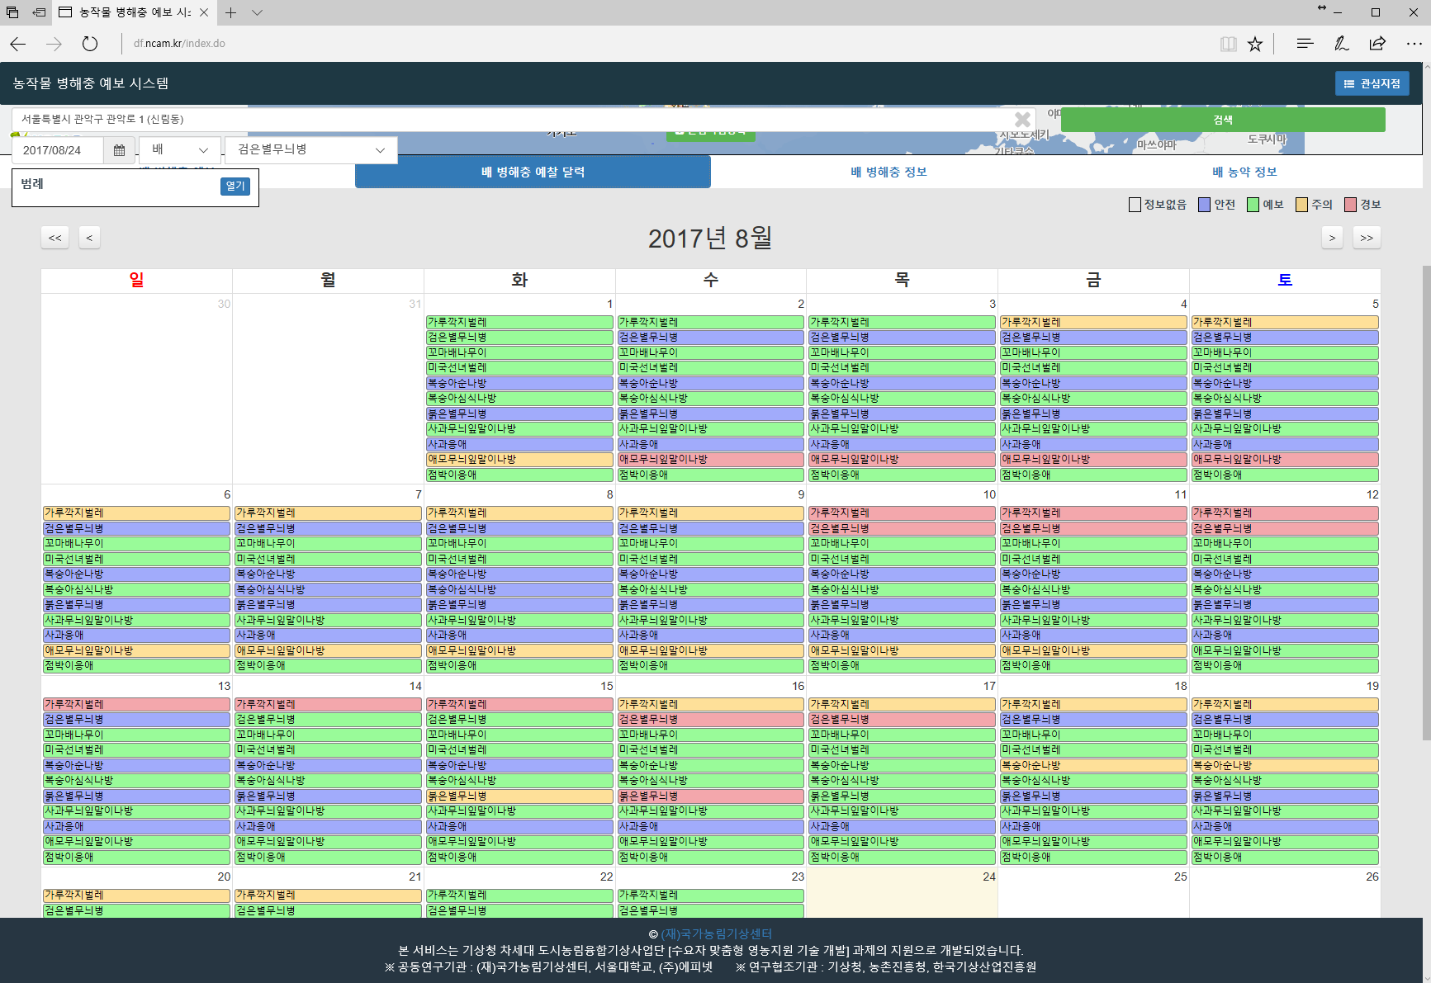
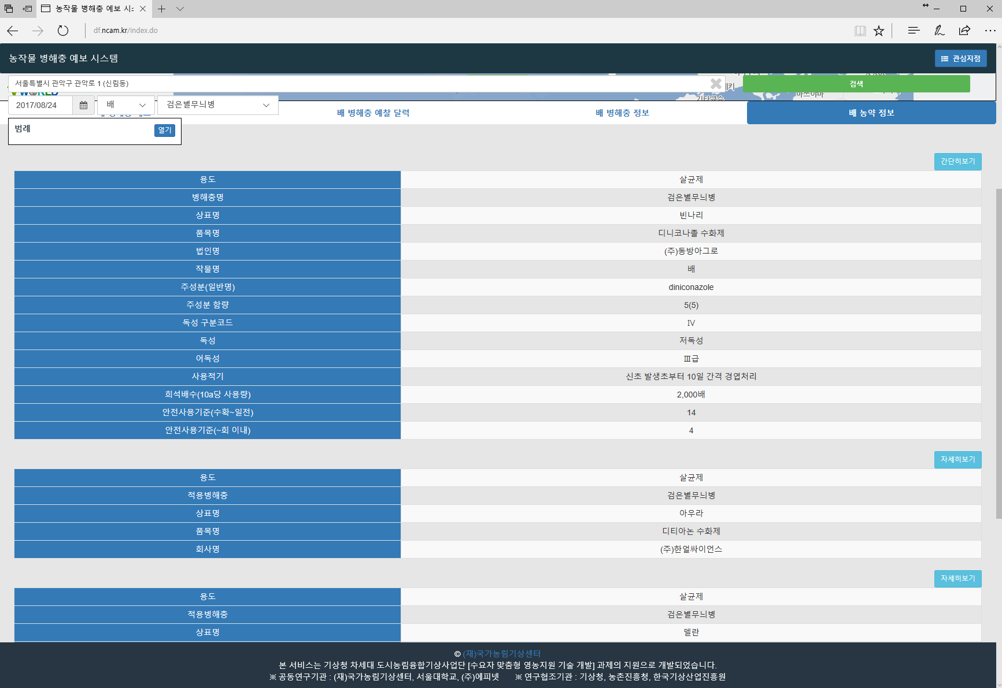
Our commodity - NCAM crop pest forecast services
Web services(http://df.ncam.kr)
Daily risk with map
Risk in the past
Pesticide information
Daily risk with map
Risk in the past
Disease & insect information
Pesticide information
Daily risk with Map
Risk in the past
Disease & insect information
Pesticide information
Disease & insect information
Daily risk with map
Risk in the past
Disease & insect information
Pesticide information

Slide 20

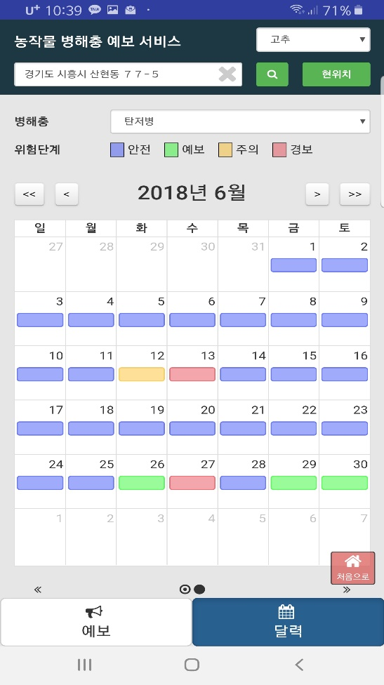
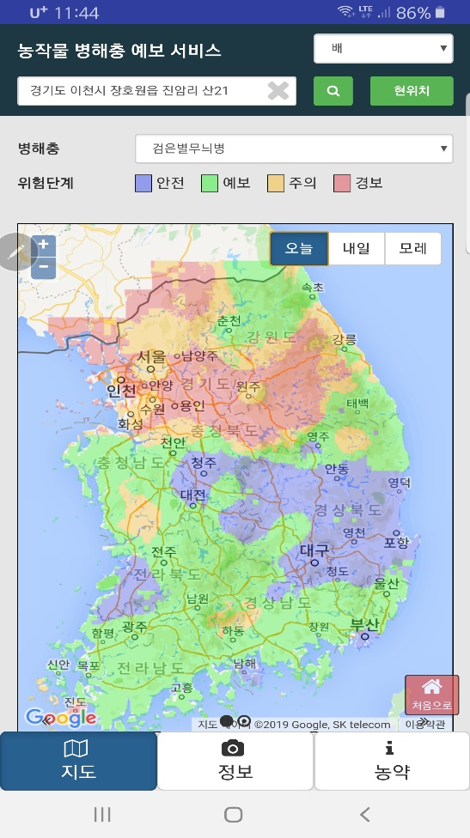
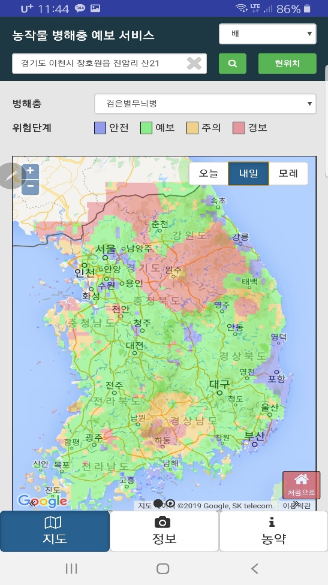
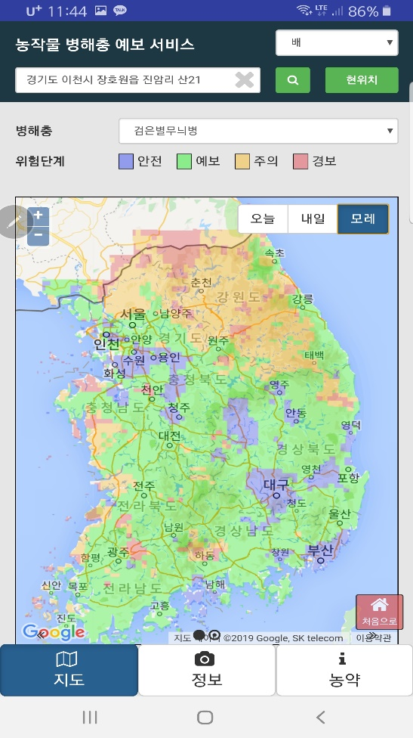
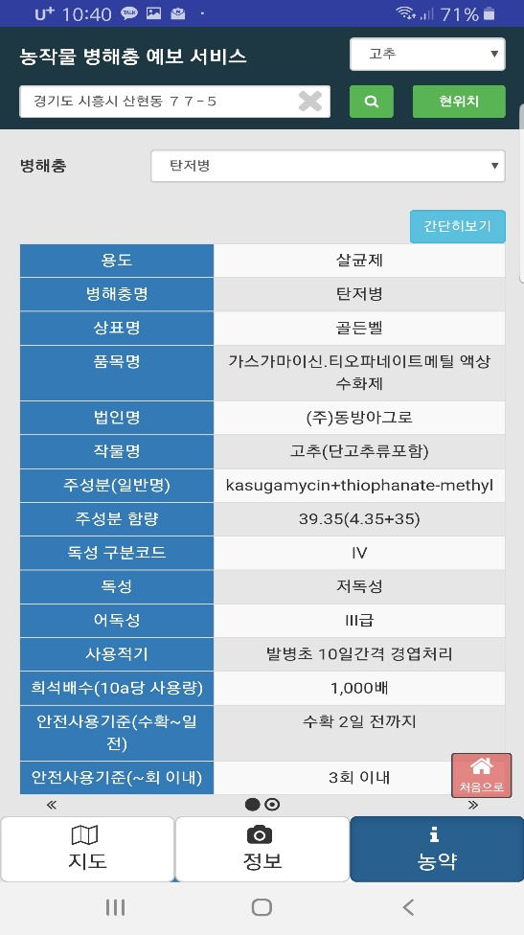
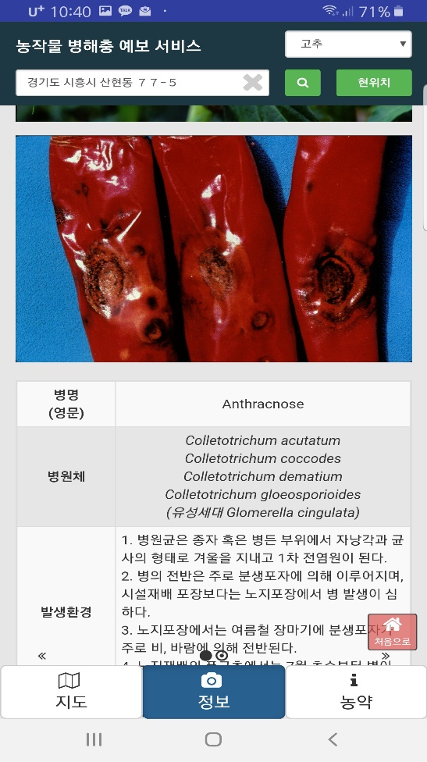
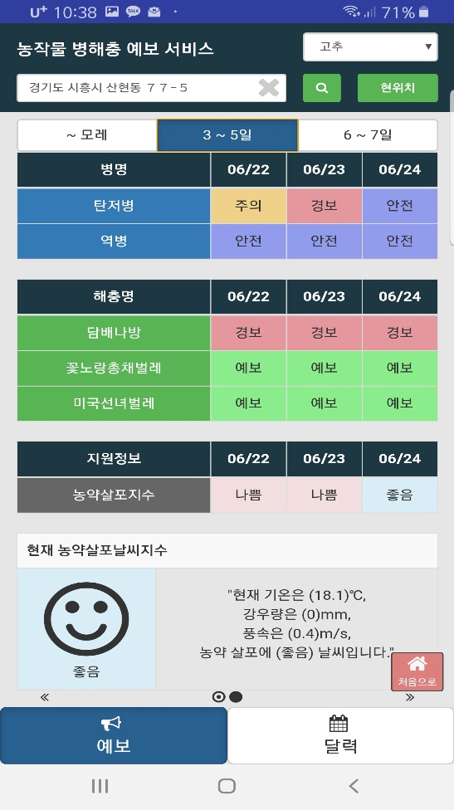
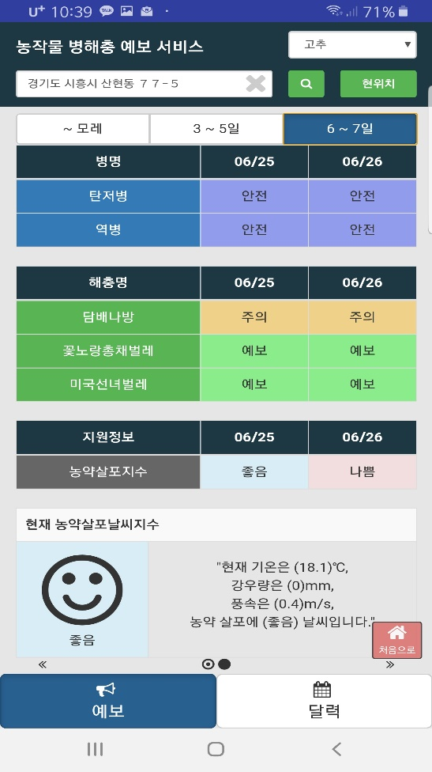
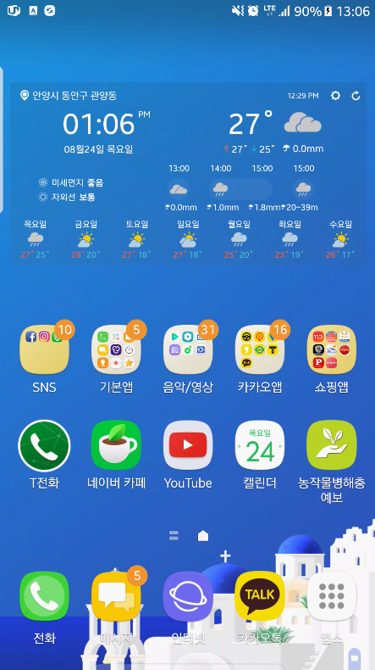

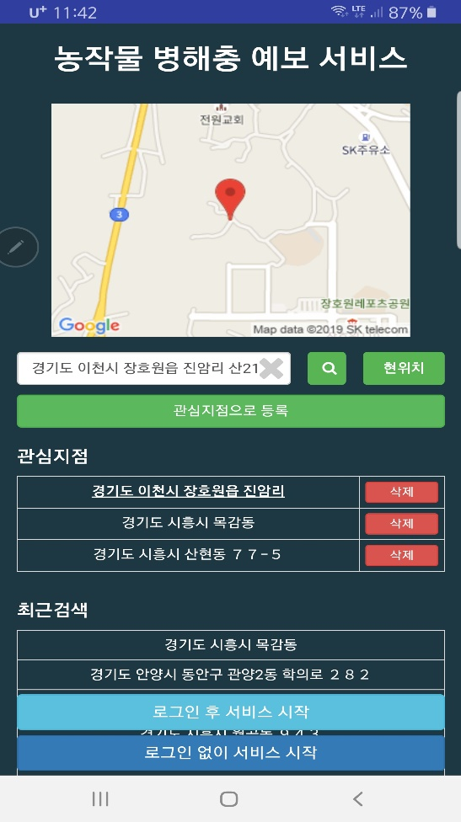
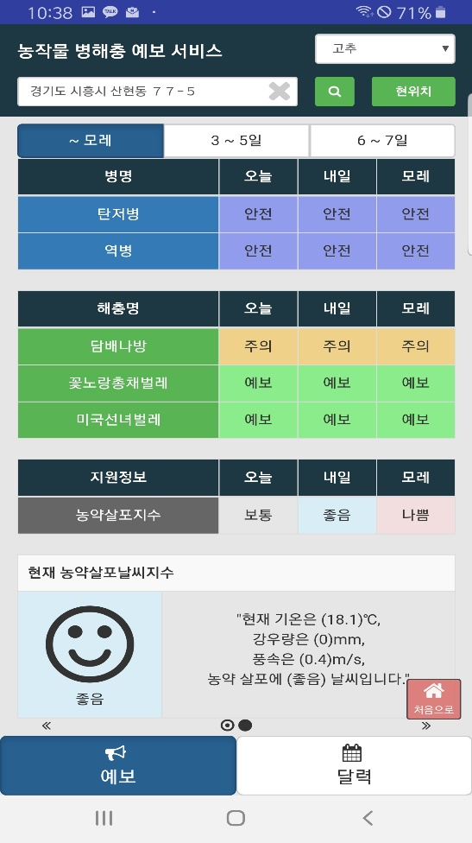
Our Commodity - NCAM Crop Pest Forecast Services
Mobile application services
First page
Site selection(3 sites registration)
Risk forecast for (D0, D+1, D+2, D+3, D+4, D+5, D+6 and D+7), Today’s pesticide spray index
Risk forecast for (D0, D+1, D+2, D+3, D+4, D+5, D+6 and D+7), Today’s pesticide spray index
Risk forecast for (D0, D+1, D+2, D+3, D+4, D+5, D+6 and D+7), Today’s pesticide spray index
Risk forecast in the past (2017~ )
Risk map at 1.5km spatial resolution for D0, D+1 and D+2
Risk map at 1.5km spatial resolution for D0, D+1 and D+2
Risk map at 1.5km spatial resolution for D0, D+1 and D+2
Disease and insect information (photo, epidemiology, & control)
Pesticide information

Slide 21
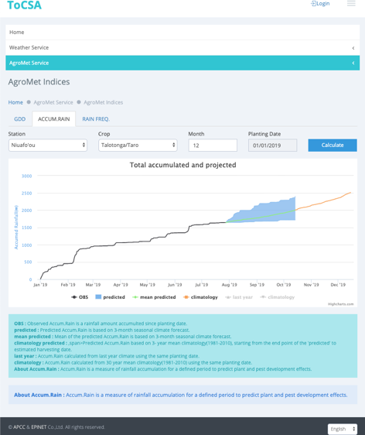
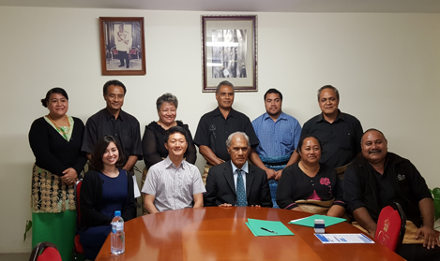
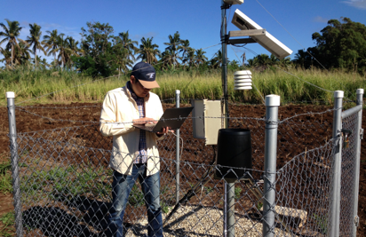
Our Commodity - Tonga Climate Services for Agriculture
Tonga AgroMet Services(http://met.gov.to:2016)
This service, together with the APEC Climate Center (APCC) and the Tonga Ministry of Agriculture and Food, Forests, and Fisheries (MAFFF) a comprehensive database was developed to bring together climate, agriculture, market and crop yield statistics from 2014 to 2016.
ToCSA is a web-based, mobile-compatible decision support system, designed to support Tongan farmers in managing and planning for the impacts of climate variability on their crops and livelihoods. ToCSA hosts multiple agro-climate services and contains:
Weather Analysis / Seasonal Forecast
Crop Yield Statistics
Crop Yield Simulator
Crop Disease Spray
AgroMet Indices
Climate Smart Farming
Soil Moisture Monitoring
With Tonga government officials
AWS on-site check
Mobile view featuring
the Farm Diary
Tonga Climate Services for Agriculture:
AgroMet Indices

Slide 22
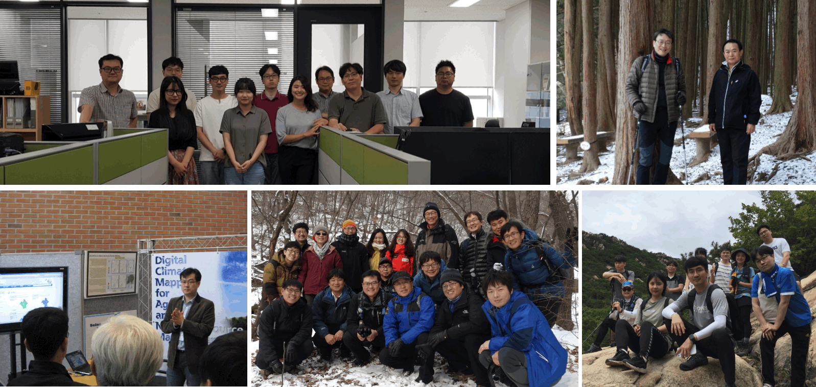
Our People
EPINET is comprised of experts with more than 10 years of specialized field experience in agrobiology and computer programming.
Thank you for your attention!

